Slide 1



Team Introduction
Team Name: CIRCUIT CRAFTERS
Team Members:
Shridhar Angadi
Shrinivas M
Vaibhav Revankar
Vanishree Kulakarni

Slide 2
Problem Statement
Problem Statement Title: Audio Frequency Analysis using Analog Circuits
Objective:
Design a low-noise analog front-end for microphone signals.
Capture audio signals using a microphone.
Amplify the weak microphone signal using a low-noise amplifier.
Remove unwanted low-frequency noise using an active high-pass filter.
Remove unwanted high-frequency noise using an active low-pass filter.
Adjust the signal amplitude using a gain/level adjustment circuit.
Shift the signal to a suitable DC bias level for the ADC.
Convert the conditioned analog signal into digital data using an ADC.
Process the digital audio signal using a microcontroller.

Slide 3
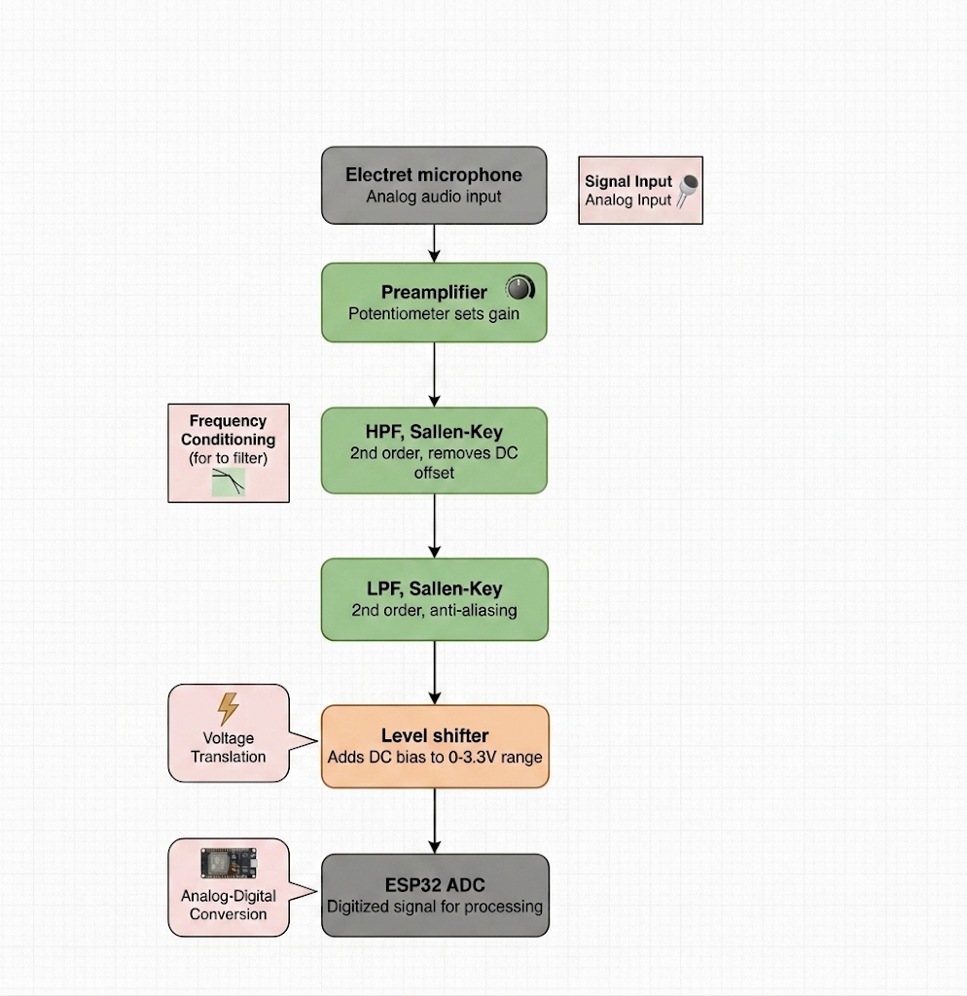
Working:
Audio Acquisition & Amplification: The electret microphone captures the audio signal, and the preamplifier boosts the weak microphone output to a suitable level with adjustable gain.
Frequency Conditioning & ADC Protection: The amplified signal passes through 2nd-order Sallen-Key HPF and LPF stages to retain the required frequency band and suppress unwanted noise; a level shifter then adds DC bias so the complete waveform stays within the 0–3.3 V ESP32 ADC range.
Digitization & Processing: The conditioned analog signal is fed to the ESP32 ADC, which converts it into digital samples for further frequency analysis, signal processing, and output/display.

Slide 4
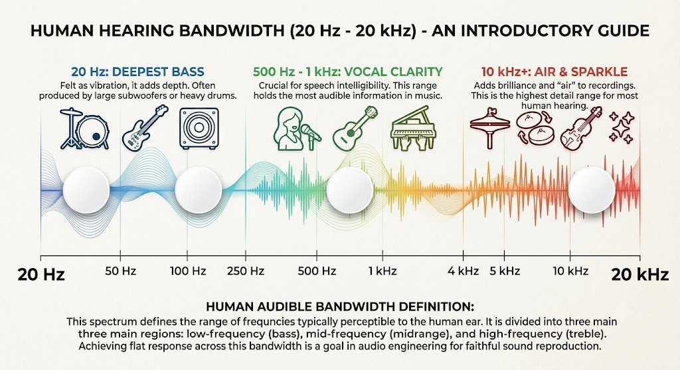
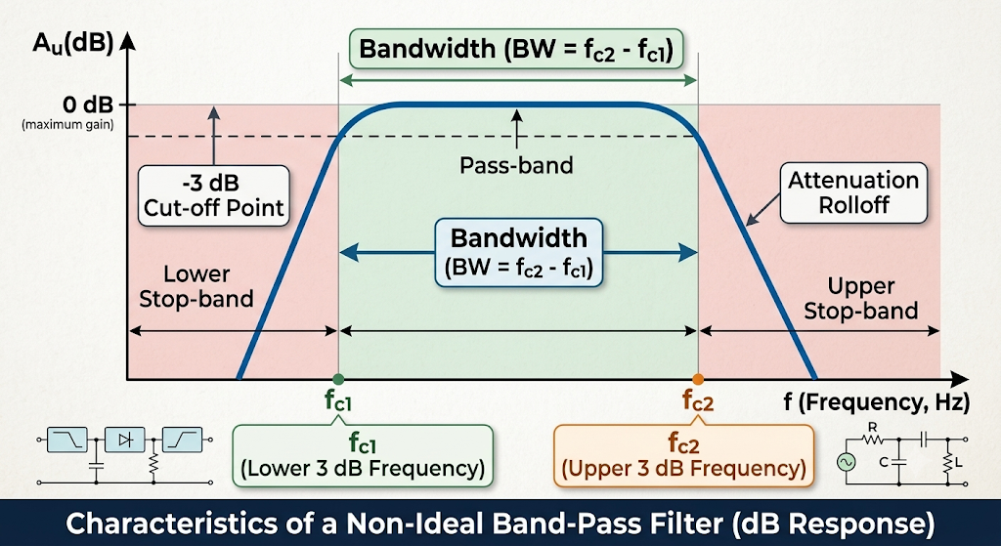
Constraints Provided:
1. Regulated Bandwidth: Adjustable bandwidth within 20 Hz–20 kHz
2. Variable Gain: Output amplitude controlled through a potentiometer-based variable gain stage
3. Microphone Interface: Ability to accept microphone input as a real-world test signal.
4. Signal Amplification: Provide a clean, amplified output while preserving the input signal characteristics

Slide 5
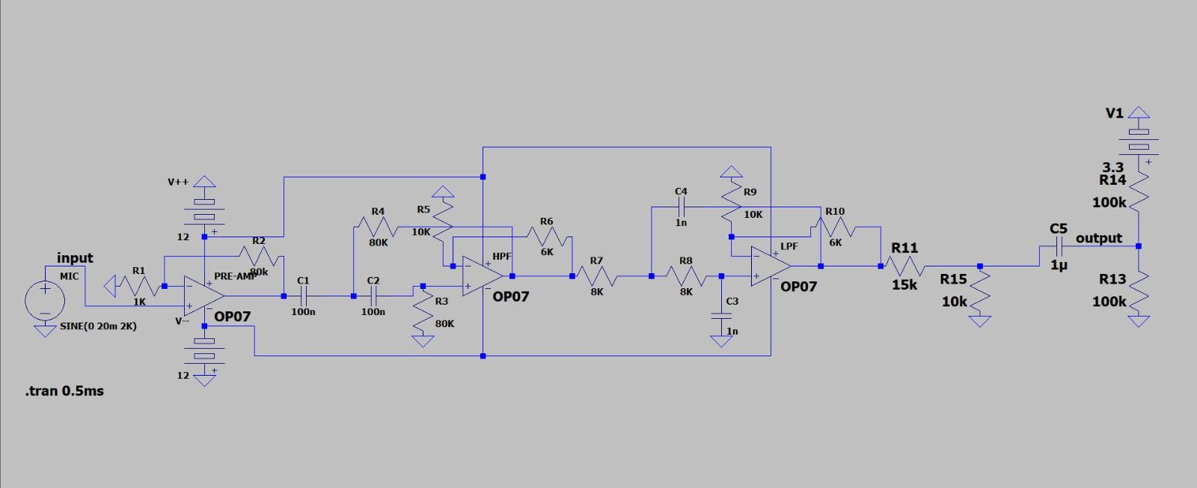
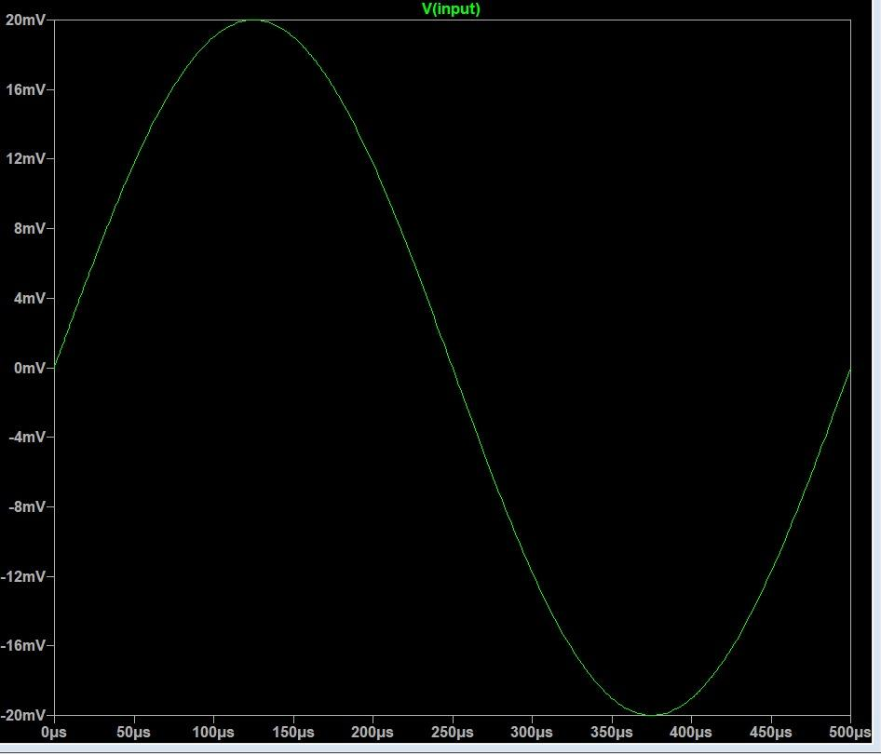
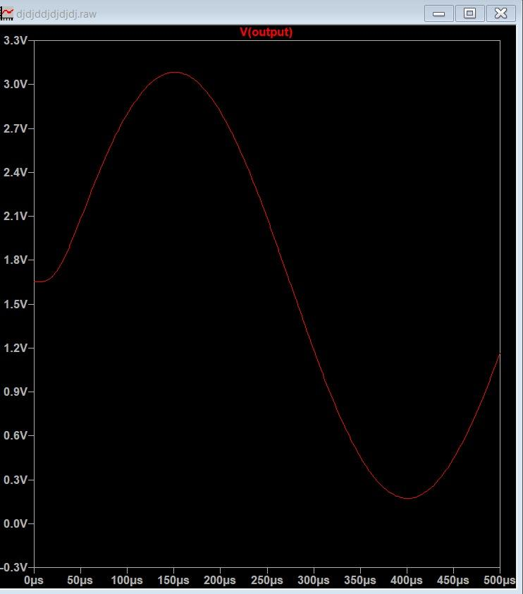
Circuit Design and Output Graphs

Slide 6

Simulation :

Slide 7
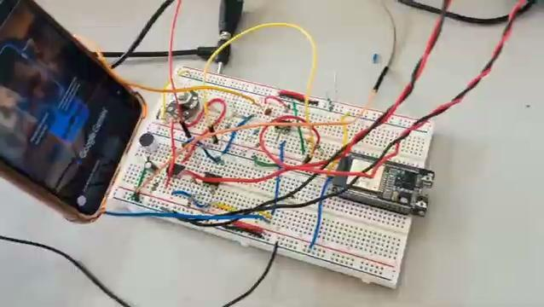
Implementation:

Slide 8
THANK YOU

